Slide 1

Natural Language Processing
Rohit Kate
Question Answering

Slide 2
Question Answering (QA)
Automatically finding answer to a user’s question
Many flavors
Search answer within a document
Search answer from multiple documents
Closed-domain: Questions about a narrow topic
Open-domain: Questions about anything
Extractive QA: Answer identified as a span inside existing text
Abstractive or Generative QA: Answer synthesized as a new text
Single mode (e.g. text)
Multimodal (e.g. text + images)
easier
easier
easier
easier

Slide 3
Extractive QA Example
Question: Which universities merged to create UWM?
Text: University of Wisconsin–Milwaukee was founded with the belief that Milwaukee needed a great public university to become a great city. In 1955, the Wisconsin state legislature passed a bill to create a large public university that offered graduate programs in Wisconsin's largest city. In 1956, Wisconsin State College-Milwaukee merged with the University of Wisconsin–Extension's Milwaukee division (a graduate branch of the University of Wisconsin–Madison) to form the University of Wisconsin–Milwaukee. The new university consisted of the WSC campus near the lakefront and the University of Wisconsin extension building in downtown Milwaukee. The first commencement of the new University of Wisconsin–Milwaukee was held on June 16, 1957. On June 13, 1958, Socialist mayor Frank P. Zeidler was the first person to receive an honorary doctorate from the university.

Slide 4
Extractive QA Example
Question: Which universities merged to create UWM?
Text: University of Wisconsin–Milwaukee was founded with the belief that Milwaukee needed a great public university to become a great city. In 1955, the Wisconsin state legislature passed a bill to create a large public university that offered graduate programs in Wisconsin's largest city. In 1956, Wisconsin State College-Milwaukee merged with the University of Wisconsin–Extension's Milwaukee division (a graduate branch of the University of Wisconsin–Madison) to form the University of Wisconsin–Milwaukee. The new university consisted of the WSC campus near the lakefront and the University of Wisconsin extension building in downtown Milwaukee. The first commencement of the new University of Wisconsin–Milwaukee was held on June 16, 1957. On June 13, 1958, Socialist mayor Frank P. Zeidler was the first person to receive an honorary doctorate from the university.
start-span
end-span

Slide 5
Extractive QA
Framed as a span classification task
For a question, identify the start-span and end-span in the given text
BERT-type model can be fine-tuned for QA task
Input: [CLS] question tokens [SEP] text tokens [SEP]
Output: Scores of a token to be start-span; scores of a token to be end-span
Scores could be probabilities or logits

Slide 6
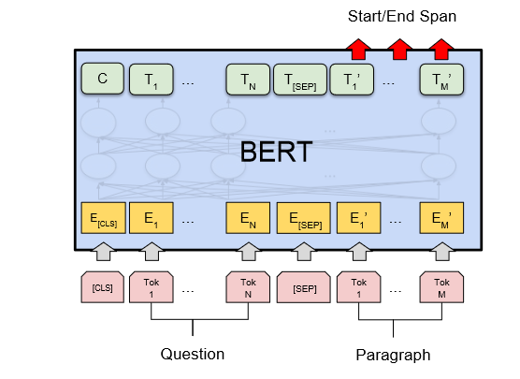
Extractive QA

Slide 7
Extractive QA
The best span is determined based on the tokens with best start-span and end-span scores constrained on
Start-span is before end-span
Both are in the scope of the text
If [CLS] token is assigned high start-span and end-span scores then the model is indicating that the answer is not in the text

Slide 8
Extractive QA
BERT-type model is fine-tuned on QA task using a large QA dataset
SQuAD dataset:
Stanford QA Dataset
https://rajpurkar.github.io/SQuAD-explorer/
https://huggingface.co/datasets/squad
150K questions asked over Wikipedia articles; collected through crowdworking
Answer to every question is a span from the corresponding reading passage

Slide 9
Extractive QA
Fine-tuned model learns how to answer a question from a passage
You could directly use a fine-tuned QA model for your QA task/domain
Sometimes called zero-shot learning
Or you could further fine-tune the QA model for your specific QA task/domain
Also called domain adaptation

Slide 10
Long Passages
BERT-type models have a hard limit on the number of input tokens (e.g. 512)
What if the text is longer than that?
For many other tasks, e.g. classification, truncating text works (assuming most information for the task is within the front part)
For QA, truncation is not a good idea because answer may be in the latter part
Solution: Apply a sliding window across the text where the window size fits the model’s input length

Slide 11
Retrieving Relevant Passages
Extractive QA assumes the passage in which the answer is possibly present was given
Realistically, user only asks the question, does not give the passage (unless it is a story-comprehension type of QA)
QA system needs to search for answer in a corpus
One option is to use the entire corpus as the “passage”, e.g. slide window through it
This will be computationally time consuming
Methods to first find relevant passages

Slide 12
Retrieving Relevant Passages
Modern QA systems have retriever-reader architecture
Retriever: retrieve relevant documents/passages
Reader: Extract answer in the retrieved passages
Same as Extractive QA
Retriever:
Sparse retrievers: Use word matches between questions and documents; each represented using word frequencies
Traditional, information retrieval (IR) method
Drawback: Cannot handle similarity if synonyms are used
Dense retrievers: Use encoders (e.g. transformer-based) to represent query and documents as embeddings and then find similarity

Slide 13
Evaluating QA
Retriever:
If the retriever misses the passage then the reader can never get the answer right
Recall: Fraction of the relevant documents retrieved
Relevant: Document(s) in which answer is present
Not an issue if some irrelevant documents are also retrieved

Slide 14
Evaluating QA
Reader:
Exact Match (EM): Span matches exactly
EM=0 if the question had no answer but the system gives one
Too strict, could underestimate performance
F1-score: Harmonic mean of precision and recall
Precision: Fraction of the predicted answer words shared with the correct answer
Recall: Fraction of the correct answer words shared with the predicted answer
Could overestimate performance
Good idea to report both EM and F1 for a balance
Could evaluate reader separately assuming a relevant passage, or evaluate the whole system

Slide 15
QA Tools
QA models fine-tuned on SQuAD are available on Hugging Face
For example:
https://huggingface.co/deepset/roberta-base-squad2
https://huggingface.co/distilbert-base-cased-distilled-squad
Haystack library provides tools to create QA system, including the retriever-reader architecture
https://haystack.deepset.ai/
Help you build your own QA system

Slide 16
Abstractive QA
Also called generative QA
What if the answer is not a span but spread across in multiple places?
Replace reader with a generator
Receives vectors of the question and the retrieved documents to generate the answer
Known as retriever-augmented generation (RAG)
Haystack includes it
Harder task

Slide 17
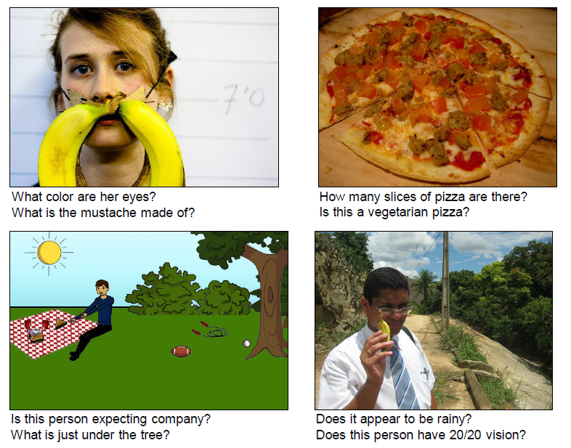
Visual Question Answering (VQA)
Answer natural language questions about information in images
https://visualqa.org/
Image from: https://arxiv.org/pdf/1505.00468.pdf

Slide 18
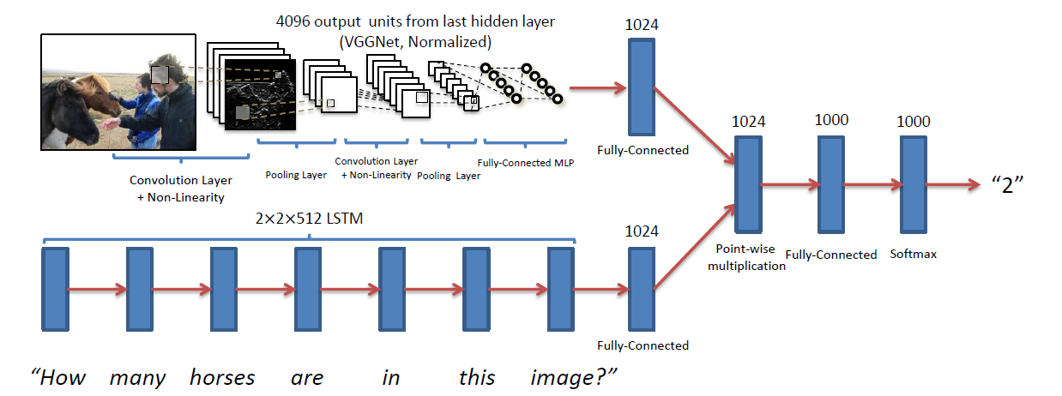
Visual Question Answering (VQA)
Image is passed through a deep neural network (typically, convolutional neural network; CNN)
Query is passed through an NLP network
The two parts are then connected with more layers
Image from: https://arxiv.org/pdf/1505.00468.pdf

Slide 19
NLP
Some topics we did not cover:
Discourse and Dialog
Summarization
In short, systems can be built analogous to MT with summarized text as the “translation”

Slide 20
NLP
Significant progress has been made in NLP
Deep learning has recently improved state-of-the-art on many tasks
Following have become commonplace in NLP
Represent words using embeddings
Leverages word similarity and generalizes to other words
Use pretrained models and then fine-tuning them
Many pretrained as well as fine-tuned models available
“Pipeline” in Hugging Face directly allows one to use them for standard tasks and domains
https://huggingface.co/docs/transformers/main_classes/pipelines#natural-language-processing
NER (standard entities), QA, summarization, classification, etc.

Slide 21
NLP
But by no means NLP is a solved problem
Current NLP systems do not really understand language as we do
They work by mostly picking-up regularities gleaned from corpora; no connection to meanings in the real world
Neural networks are black-boxes, we do not know what they are doing
NLP is an active research area with a lot of room for improvement

Slide 22
Adversarial Text
Deep learning methods can be “fooled” by specially constructed examples, called adversarial examples
For example, text can be maliciously augmented to confuse a question answering systems
It shows the system does not work by understanding the language as we do
Here a system trained to answer
questions from a text was initially giving
the correct answer. But after
adding an extra irrelevant sentence
(in blue), it gave the wrong answer.
(Example from Jia & Liang, 2017)

Slide 23
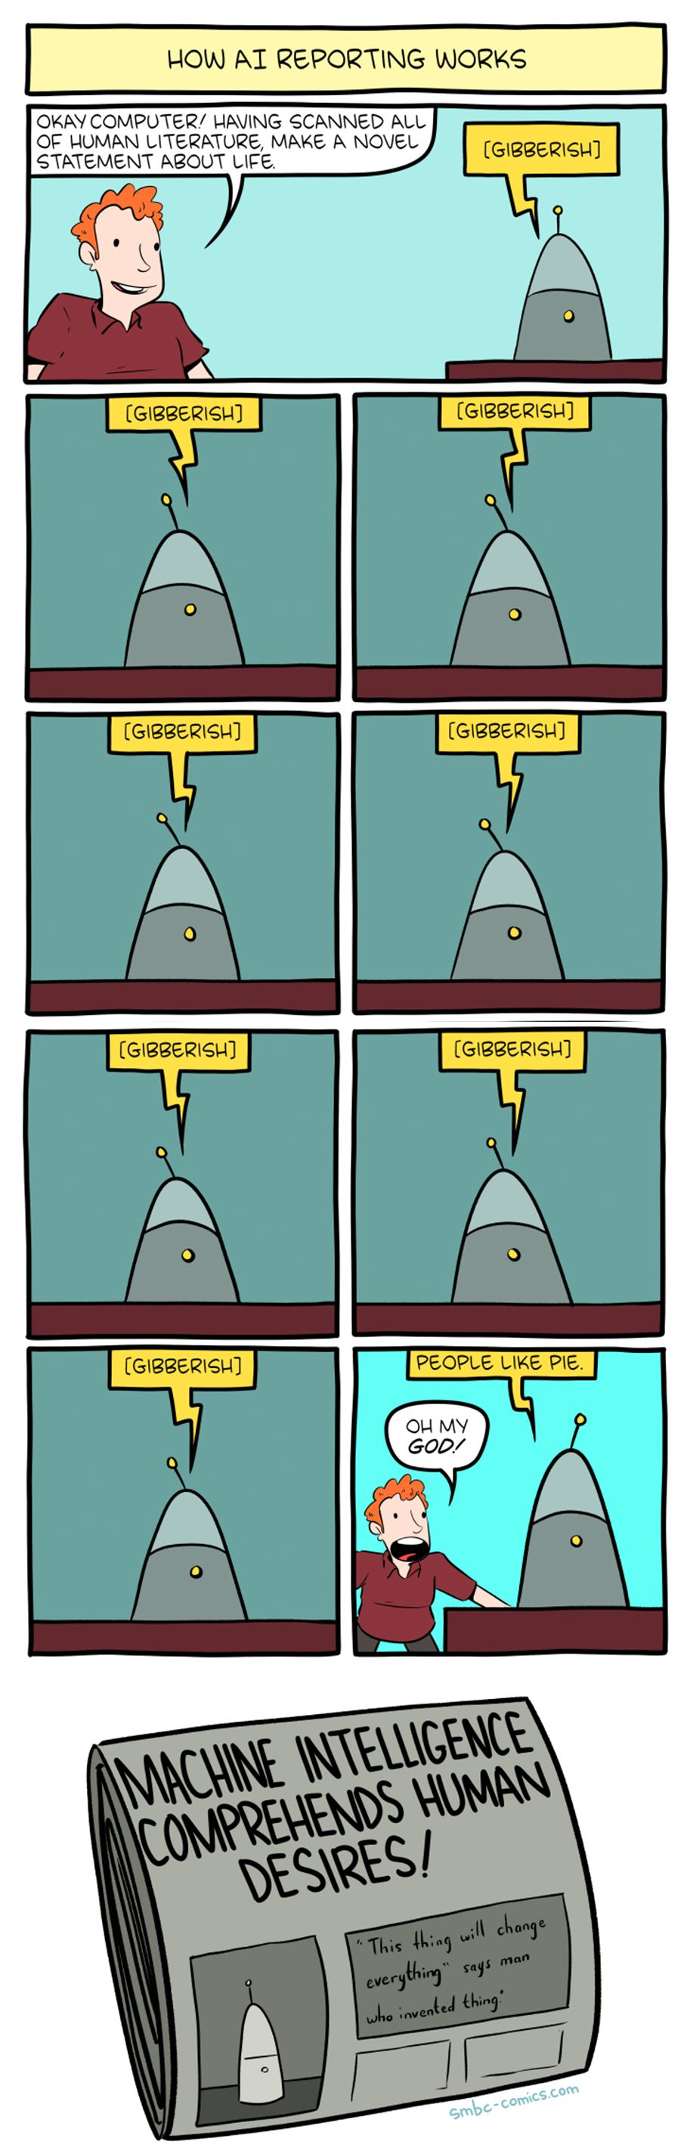
Beware of the Hype
Source: https://www.smbc-comics.com/comic/ai-8

